Slide 1
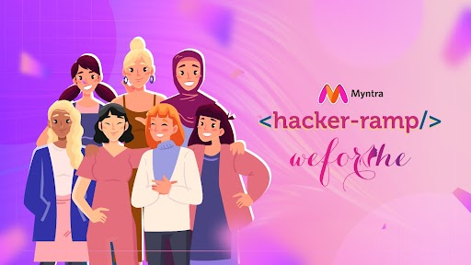
Team Name : TechTrend
Team Details :

Slide 2

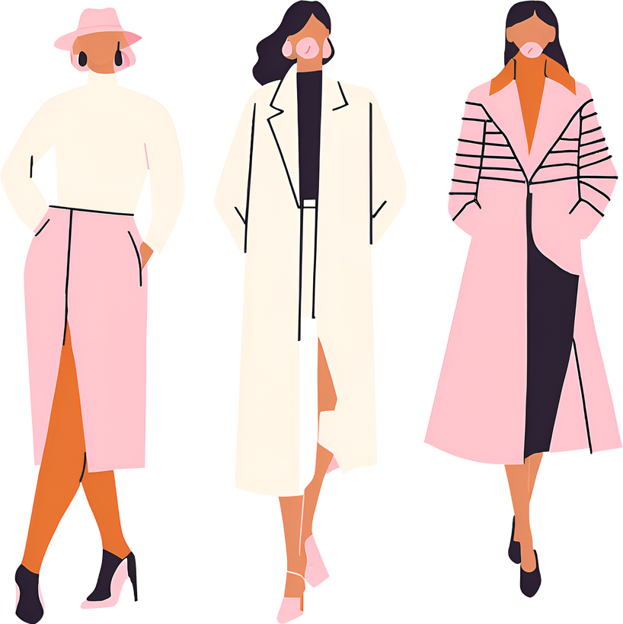

















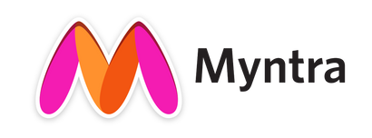
Fashion Trend Identification & Platform Engagement
Problem Statement:
Fashion trends change rapidly, making it difficult for retailers to keep up and connect with Gen Z.
Engaging this audience requires innovative approaches, including advanced trend analysis and AR-enhanced product views.
02
04
Trend Volatility
Engagement Challenges
Rapidly changing fashion trends require quick adaptation and product development.
Limited Data Insights
Traditional marketing strategies struggle to resonate with digitally-native, younger audiences.
Competitive Landscape
Traditional market research methods often fail to capture real-time trends and consumer preferences.
The online retail market is highly competitive, requiring innovative solutions to stand out.
01
03

Slide 3
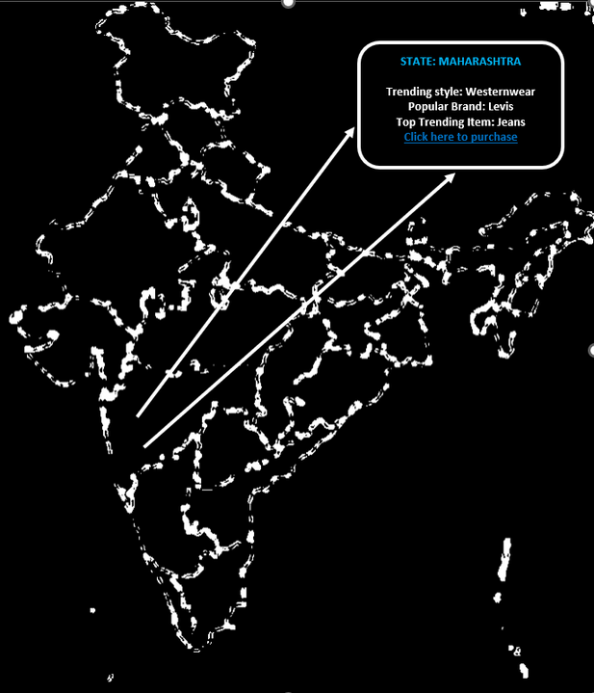
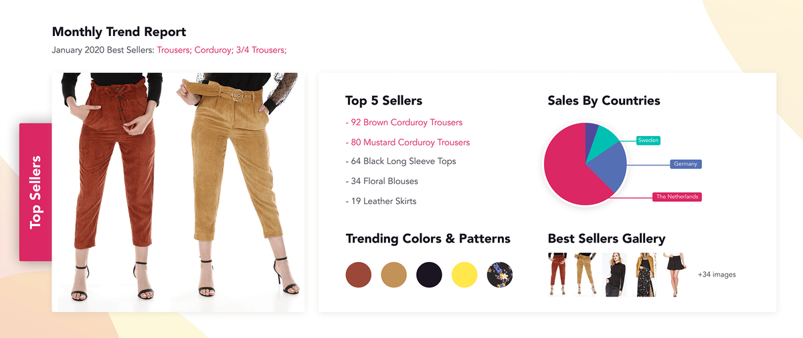





1
Interactive Dashboard
:Trend Analysis
Objectives:
To increase user engagement and decision-making on Myntra.
To offer valuable insights for users
To make shopping easy, interactive and data-based.
To provide a user-sentiment analysis and show a detailed review breakdown
To give state-specific insights to users using an interactive map.
Comprehensive data display-: Most popular brand, Trending styles, Top trending products.
Techstack
Python,Scikit-learn: ,pandas
AI
POWERBI
REACTJS
States
UP
Data Processing & Analysis
Data Training
OpenAI
Using this tool for visualizing
Frontend Development
Bangalore
Maharashtra

Slide 4
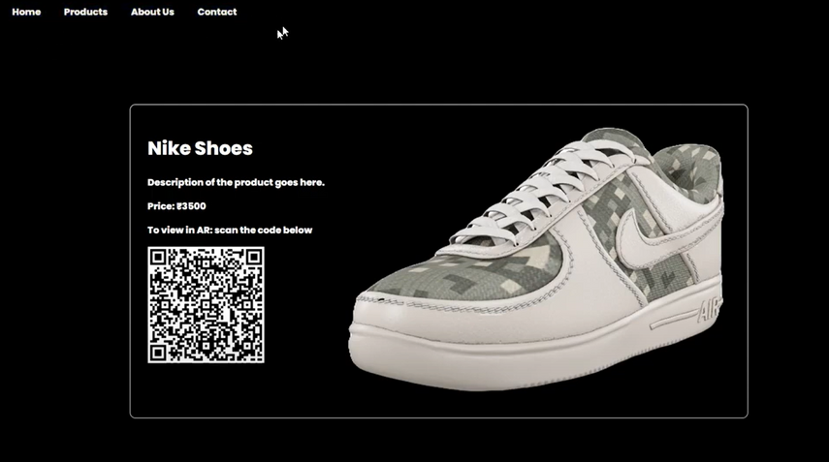
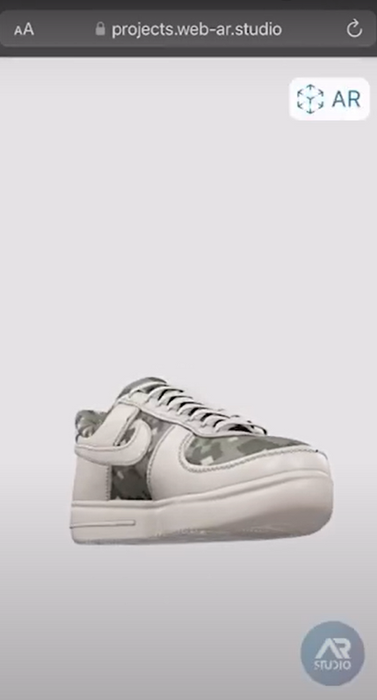
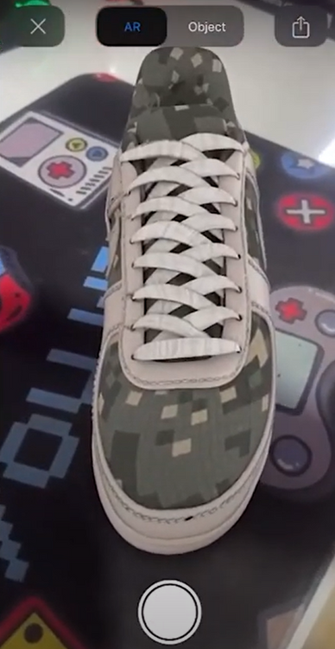
Viewing products in Augmented reality:
2
Users can scan QR codes to view 3D models of products on their devices, enabling them to zoom, rotate, and examine the items in detail. Additionally, users can activate AR mode to see how the products would look in their real environment, enhancing the shopping experience by providing a realistic visualization.
Objective
Higher Sales: Increased confidence boosts conversions.
Better Satisfaction: Accurate previews enhance customer satisfaction.
Innovative Image: Reinforces Myntra's tech-savvy reputation.
Techstack
AR CODE
studio
REACTJS
3D Modeling
Frontend Development

Slide 5
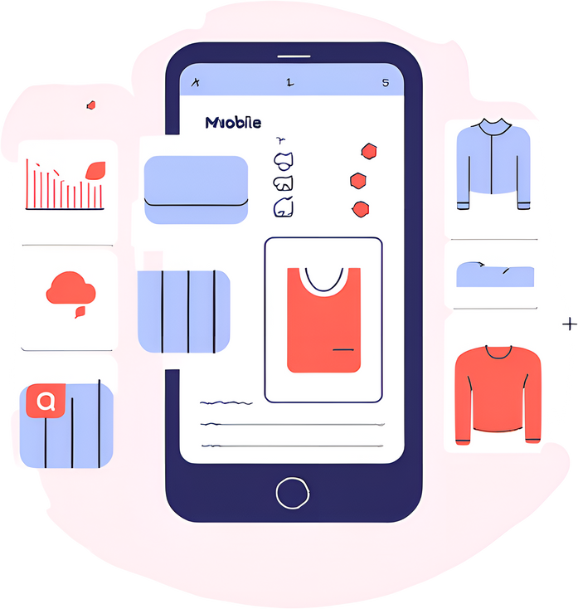
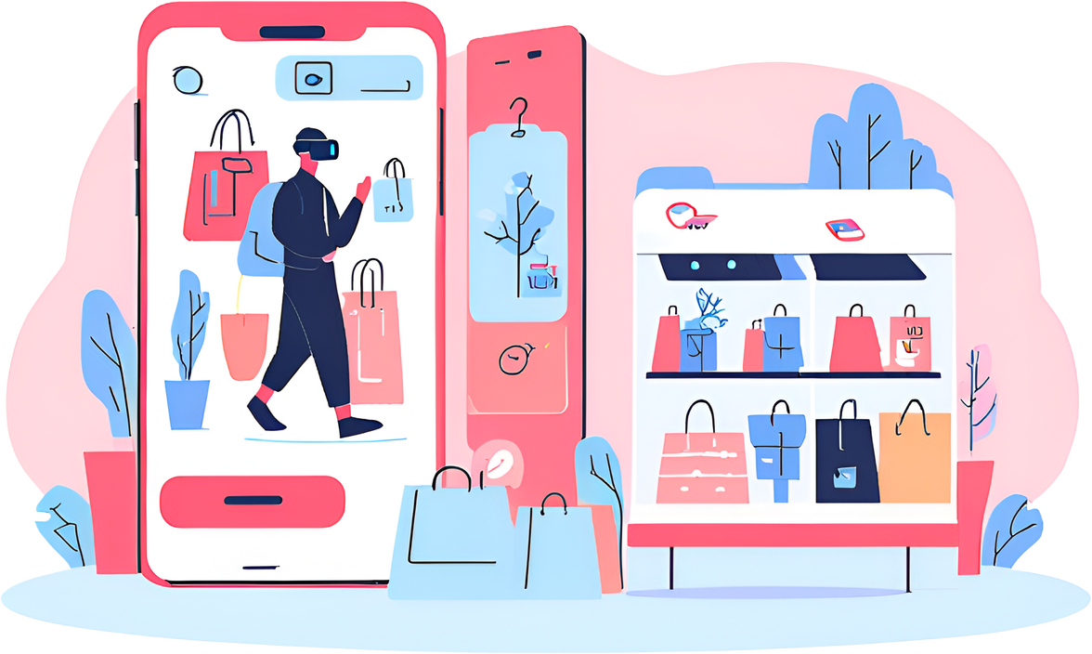
BENEFITS
This both solution offers numerous benefits for both the retailer and the consumer.
Retailer
Consumer
Improved trend prediction accuracy
Personalized shopping experience
Enhanced product development
Increased engagement and community building
Increased sales and revenue
Access to real-time fashion trends
Improved decision making through user reviews
and Reduced Returns
Enhanced brand loyalty

